Slide 1
Logistic Regression Case study: Credit Scoring Model
Submitted By - Digant Vaibhav Gupta
Jigsaw Id : Jig14480
Mob :9745032462

Slide 2
Title of Contents
Introduction
Problem Statement
Solution Design
Solution Implementation
Data Exploration
Data Preparation
Model Creation
Validation
Findings of the model

Slide 3
Introduction
A credit card company wants to build a credit scoring model, to predict the bad customers.
The company has data on customers involving the details about the demographic and credit bureau variables.

Slide 4
Problem Statement
Analyze the past behavior of customers to gain the knowledge about the profile of customers who have a high chance of defaulting on the credit card loans.
Develop a model which predicts the chances of defaulting based on demographic and credit bureau information available to us.
Apply this knowledge to predict the chances of defaulting for the future customers by creating a scoring model for every individual customer based on the model.
Thereby letting the company to choose it’s potential customers according to risk appetite of the business.

Slide 5
Solution Design
Dependent variable is NPA_STATUS which is a binary variable and can only take value as 1or 0
NPA_STATUS =1 indicates the customer has defaulted
NPA_STATUS =0 indicates the customer has not defaulted
Since it is a binary variable we will use logistic regression to predict the values of NPA_STATUS based on the various demographic and credit bureau variables.

Slide 6
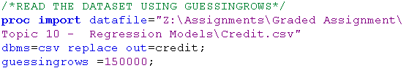
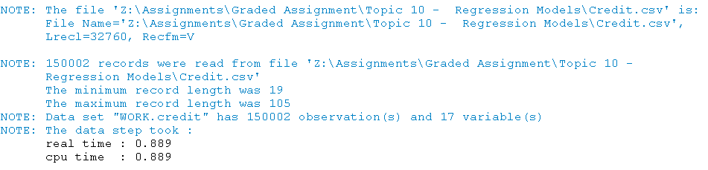
Data Extraction
Check contents of the data

Slide 7

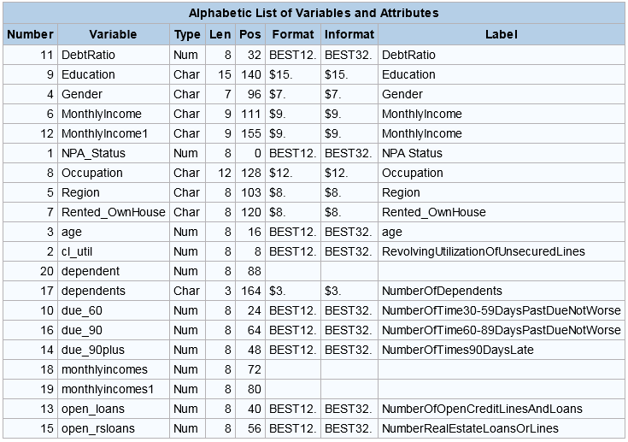

Slide 8
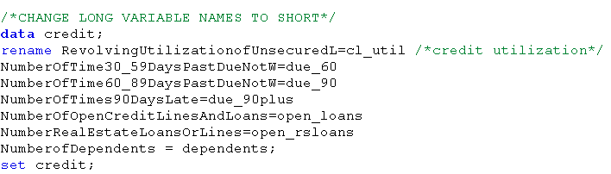
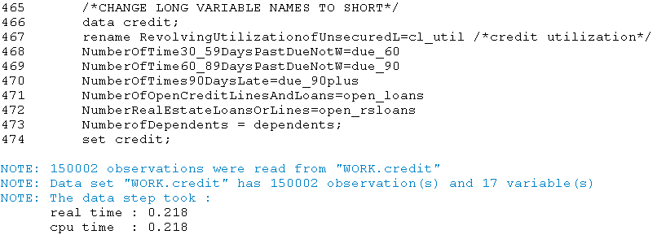
Change long names to short and readable names

Slide 9
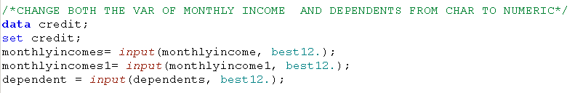
Change data-type of numeric variable

Slide 10

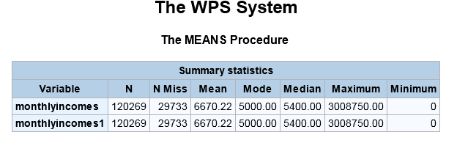
Check the duplicate columns of income

Slide 11

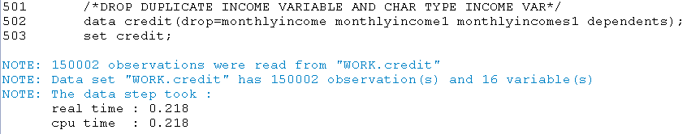
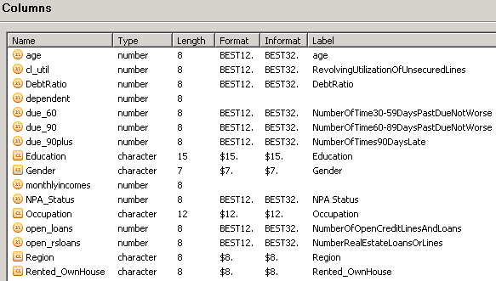
Delete the duplicate variable

Slide 12

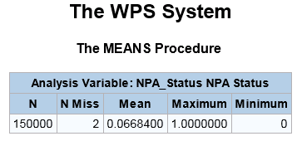
Check variable NPA_STATUS

Slide 13

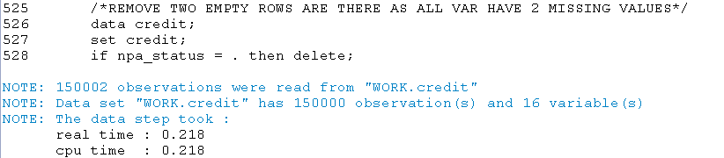
Remove missing value from NPA_Status

Slide 14

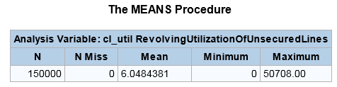
Check variable cl_util: Notice it has values greater than 1

Slide 15

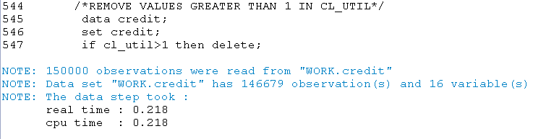
Remove the values of cl_util greater than 1 as we know that credit limit utilization cannot exceed the credit limit

Slide 16
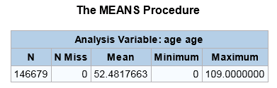
Check variable age Notice 0 values

Slide 17
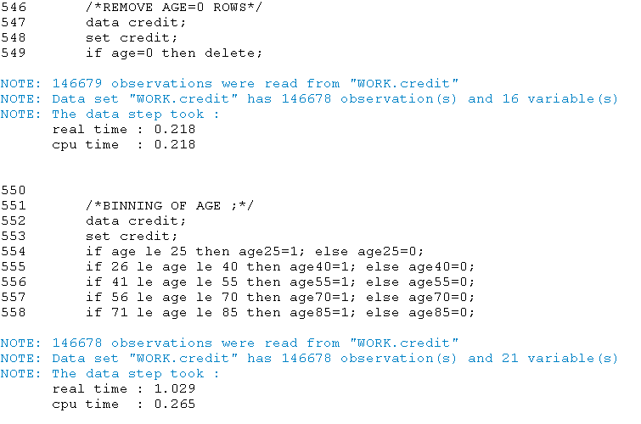
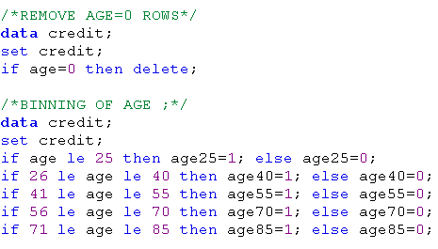
Remove 0 and create bins of age

Slide 18
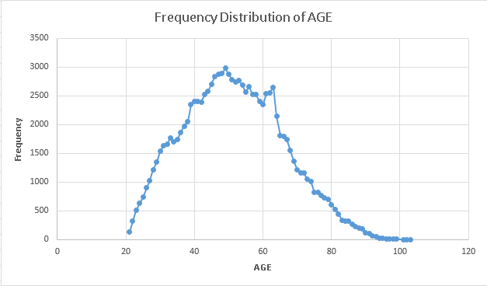
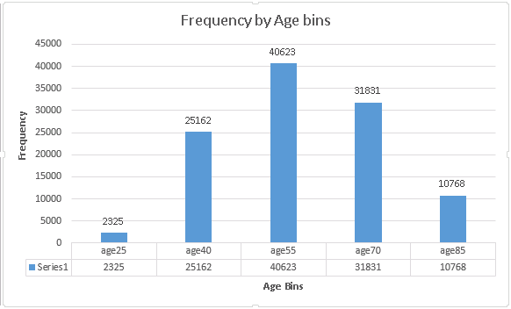

Slide 19

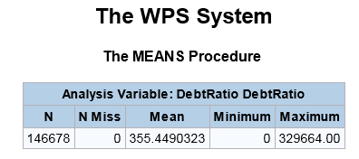
Check variable debtratio: Notice values >=1

Slide 20

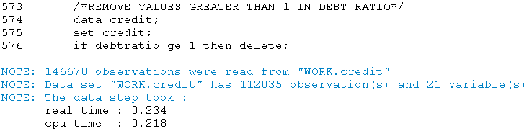
Remove values >= 1 as total expenditure(debt/alimony/living costs)cannot exceed the income

Slide 21
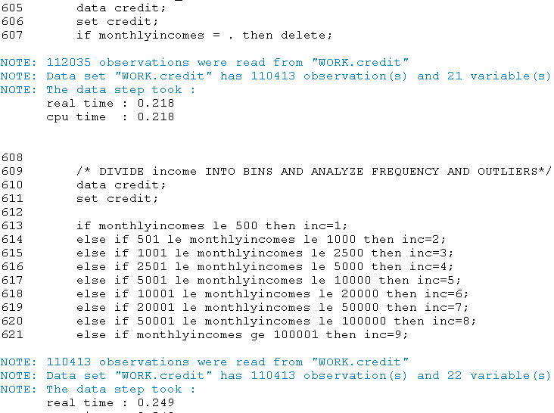
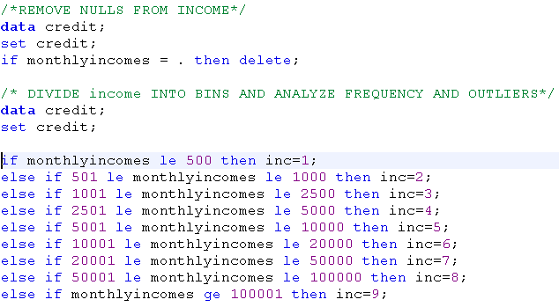
Remove missing values from income and create bins

Slide 22
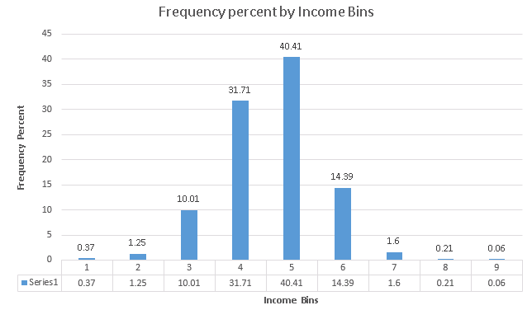
Inc1 , Inc8 and Inc9 can be considered as outliers

Slide 23
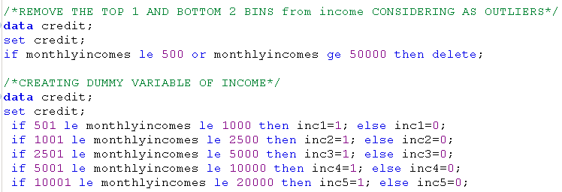
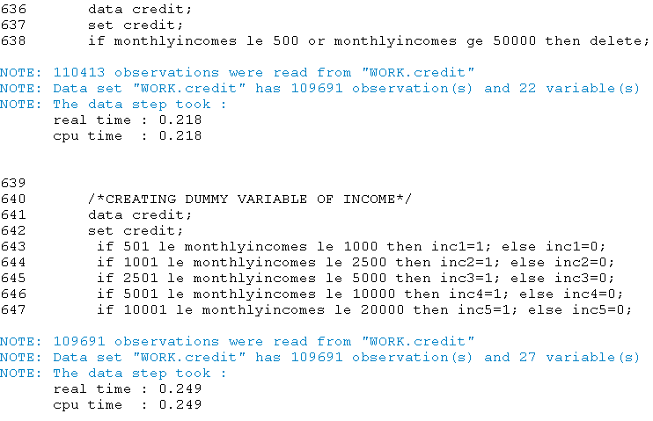
Remove outliers and create dummy variable for Income

Slide 24
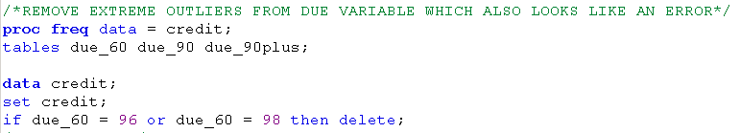
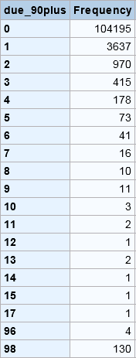
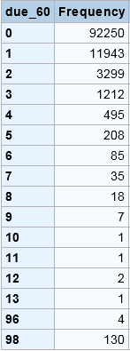
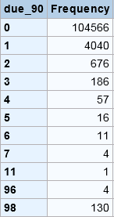
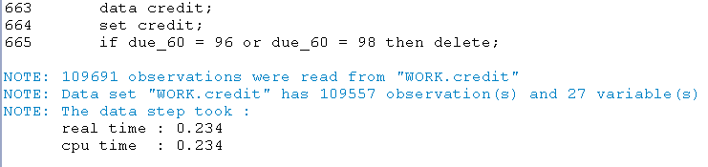
Check variables due_60 due_90 and due_90plus Notice all have same frequency for last two values

Slide 25
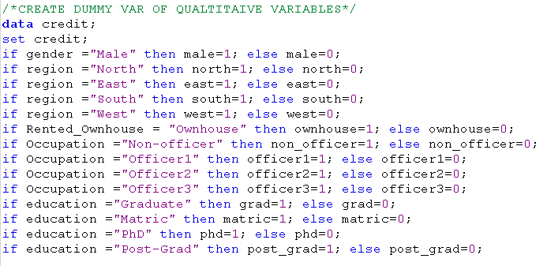
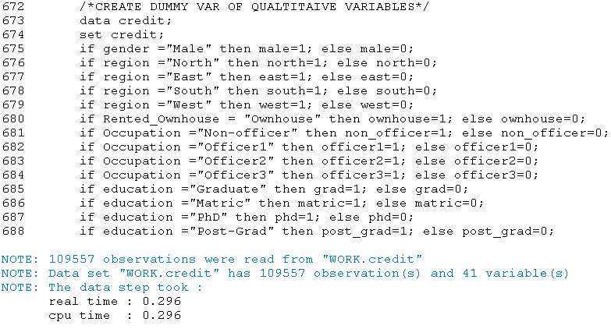
Create quantitative variables for all qualitative variables

Slide 26
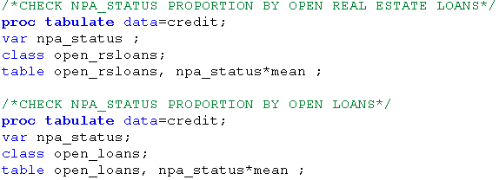
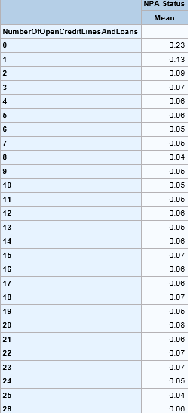
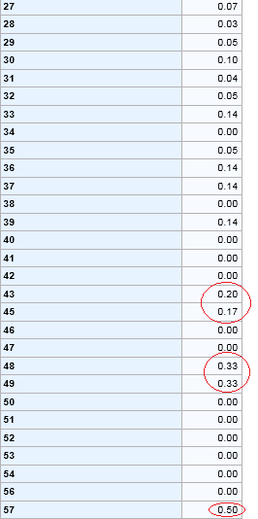
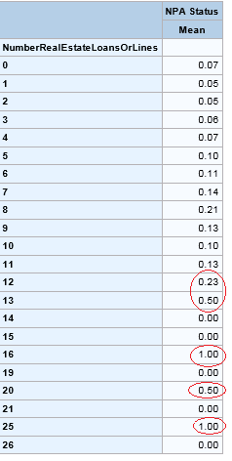
Not removing outliers from open_loans and open_rsloans as we expect high number of loans are reason of NPA

Slide 27
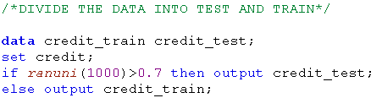
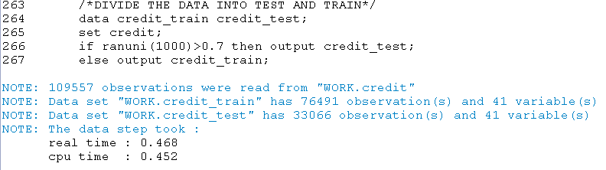
Divide the dataset into train (70%)and test (30%)

Slide 28
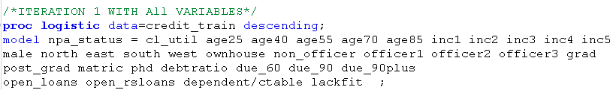
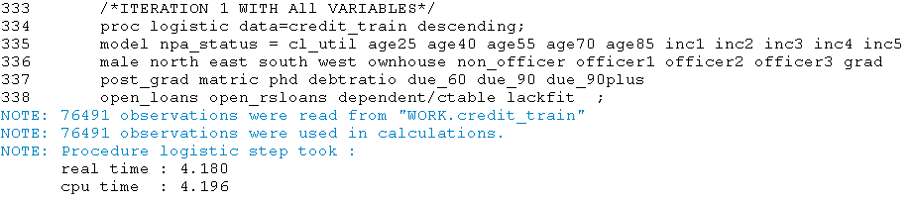
ITERATION:1 Run Logistic Regression with all variables on train data

Slide 29
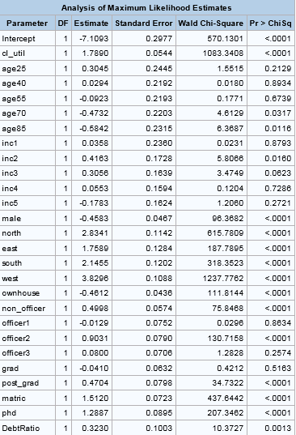
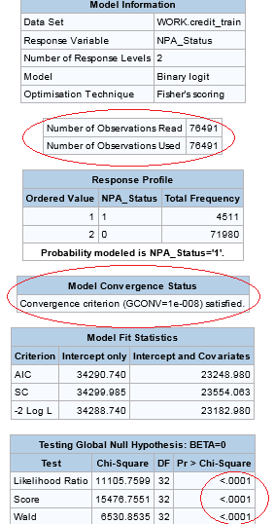

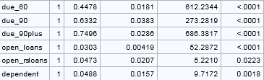
ITERATION 1: OUTPUT All the red encircled values tell us that we are headed in the right direction. We will discuss these values in the coming sections

Slide 30
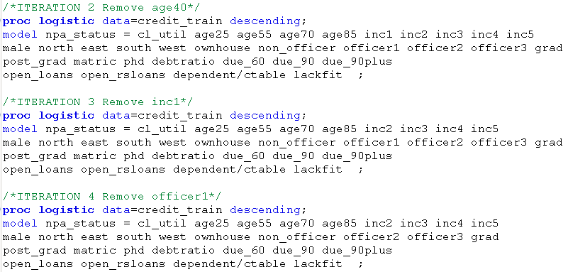
ITERATION 2,3,4: Removing insignificant variables by selecting the largest p value and removing one by one until all variables are significant at 95% confidence

Slide 31
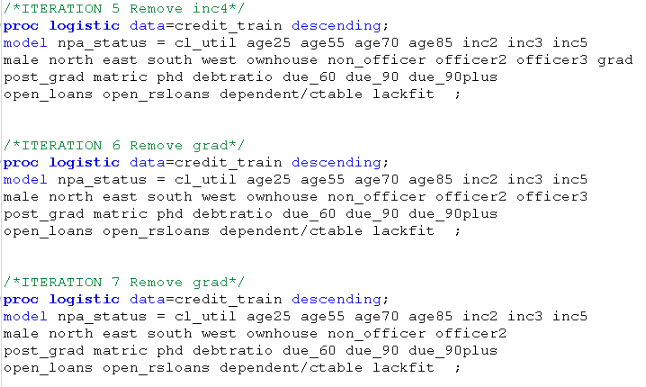
ITERATION 5,6,7: Removing insignificant variables by selecting the largest p value and removing one by one until all variables are significant at 95% confidence

Slide 32
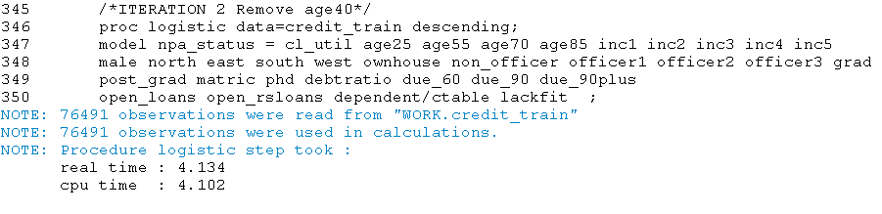
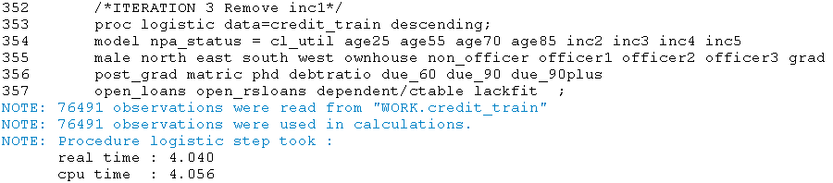
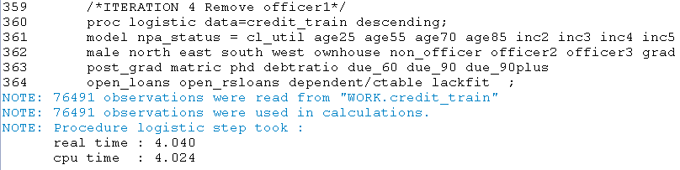
Log output of ITERATION: 2,3,4

Slide 33
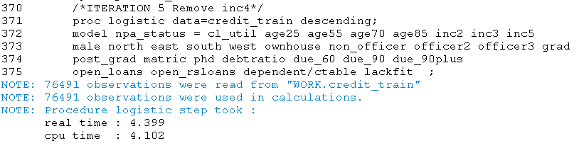
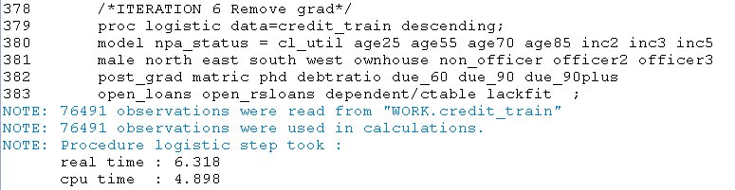

Log output of ITERATION: 5,6,7

Slide 34

Final Model and Ranking

Slide 35



Slide 36

Model Validation -1
All the 76491 observations of the train dataset have been read and utilized for model building.
Model convergence criteria is satisfied.
We have achieved minimum value of AIC, SC and –log2 L for the column Intercept and covariates as compared to the previous models.
Global null hypothesis that all the variables are significant is rejected accepting the alternate hypothesis that at-least one variable is significant.

Slide 37

Model Validation 2
Notice for all the variables Pr > ChiSq is less than 0.05
This means that all the variable are significant at 95% level of confidence.

Slide 38

Model Validation 3
We have achieved a high concordant percentage of 88.6
Thus essentially means that for every possible combination of two observations in our dataset, the model accurately predicts 88.6% of the times as to which observation is closer to 1 and which one is closer to 0 as compared to the NPA_STATUS values.

Slide 39
Model Validation 4 Classification/Confusion matrix
Selecting 0.5 as the threshold ( if p>0.5 then event else non-event ) in the classification matrix we will get a confusion matrix of True Negatives (TN), True Positives (TP), False Negatives (FN) and False Positives (FP)
Accuracy = Correct Predictions/Total Predictions
Accuracy = (TP+TN) / (TP+TN+FP+FN) = (71530+1073)/(71530+1073+450+3438)
Accuracy =72603/76491 = 95%
 | Predicted Non-Events (0) | Predicted Events (1)
Actual Non-Events (0) | True Negatives (71530) | False Positives (450)
Actual Events (1) | False Negatives (3438) | True Positives (1073)

Slide 40
Model Validation 5 : Gain Chart Explains the gain of model over predictions of non-model

Slide 41

Test set scoring using model

Slide 42


Log Output: Test set scoring using model

Slide 43
Gain Chart of Test Set

Slide 44
Scoring file is stored in the given path
The file named “test_decile .csv“ and “train_decile.csv” are generated as an output of the model which has a variable p_1 which gives the probability of defaulting for each and every customer.
This variable can be adjusted according to the risk appetite of the business and they can select a threshold value below which they would consider issuing credit cards as risky.

Slide 45

Interpretation
Assuming we change one factor at a time and others are kept constant.
We will examine the resultant change in the Dependent Variable : P(Default) / 1-P(Default)
Odds of a person defaulting on credit card loans
cl_util :Increase in 0.1 in the value of cl_util will result into an increase of (5.98^0.1=1.19) 19% in the odds of defaulting.
Age25: A customer of age less than 25 is 31% more likely to default as compared to a 25-40 aged customer.
Age55: A customer of age 40-55 is 12% less likely to default as compared to a 25-40 aged customer.
Age70: A customer of age 55-70 is 40% less likely to default as compared to a 25-40 aged customer.

Slide 46
Age85: A customer of age 70-85 is 45% less likely to default as compared to a 25-40 aged customer
Inc2 : A person earning between 1000-2500 is 43% more likely to default on a loan as compared to a person earning less than 500 or in the range of 5000-10000
In3 :A person earning between 2500-5000 is 28.6% more likely to default on a loan as compared to a person earning less than 500 or in the range of 5000-10000
In5: A person earning between 10,000-20,000 is 20% less likely to default on a loan as compared to a person earning less than 500 or in the range of 5000-10000
Male: Male customer are 36% more likely to default as compared to female customers
North: A person from north is 16 times more likely to default as compared to a person living in central region.
East: A person from east is 5.8 times more likely to default as compared to a person living in central region.
South: A person from south is 8.5 times more likely to default as compared to a person living in central region.
West: A person from west is 46 times more likely to default as compared to a person living in central region.
Ownhouse: A person having his own house is 36% less likely to default as compared to a person living in rented house.

Slide 47
On-officer: A non-officer is 61% more likely to default as compared to officer1 or officer3 or self employed person
Officer2: A officer-2 is 2.4 times more likely to default as compared to officer1 or officer3 or self employed person
Post grad : A post graduated person is 66% more likely to default as compared to a professional educated person
Matric : A matric pass person is 4.5 times more likely to default as compared to a professional educated person
PhD: A PhD person is 3.6 times more likely to default as compared to a professional educated person
Debt Ratio: A 0.1 increase in debt ratio will increase the chances of defaulting by 3% (1.39^0.1=1.033)
Due_60 : A unit increase in no of times a person has delayed the payments by 30-60 days (but not worse) will increase the odds of defaulting by 56%.
Due_90 : A unit increase in no of times a person has delayed the payments by 60-90 days (but not worse) will increase the odds of defaulting by 88%.
Due_90plus :A unit increase in no of times a person has delayed the payments by more than 90days will increase the odds of defaulting by 211%.
Open Loans :A unit increase in number of open loans of a person will increase his chances of defaulting by 3.1%
Open Real Estate Loans : A unit increase in number of open real estate loans of a person will increase his chances of defaulting by 4.7%
Dependents: A unit increase in number of open dependents of a person will increase his chances of defaulting by 5%

Slide 48
Thank You & Have a Nice Day!!

